Slide 1

CAPSTONE PROJECT
Employee Salary Prediction
using Machine Learning
A Data-Driven Approach to Fair Compensation
Presented by: T.R.J. Swarup Reddy
Andhra University - CSE (2nd year)

Slide 2








Agenda
This presentation outlines our approach to developing a data-driven salary prediction system using machine learning techniques.
Problem Statement
System Development Approach
Algorithm & Deployment
Results & Implementation
Conclusion
Future Scope
References

Slide 3


Problem Statement
Human Resource departments face significant difficulties
in determining
fair and competitive salary structures
for
Traditional vs. Data-Driven Approach
employees across different departments and experience
Objectivity
Low
levels.
Objectivity
High
Traditional methods rely on subjective assessments leading to inconsistent compensation decisions
Consistency
Low
Consistency
High
Lack of data-driven approach creates difficulty in maintaining competitive market positioning
Low
Scalability
Scalability
High
Employee dissatisfaction due to perceived unfairness in compensation
Employee Satisfaction
Low
The Need:
An automated, objective system that can predict employee salaries based on measurable factors such as years of experience, job performance ratings, and other relevant metrics to ensure fair compensation and optimal budget allocation.
Employee Satisfaction
High

Slide 4

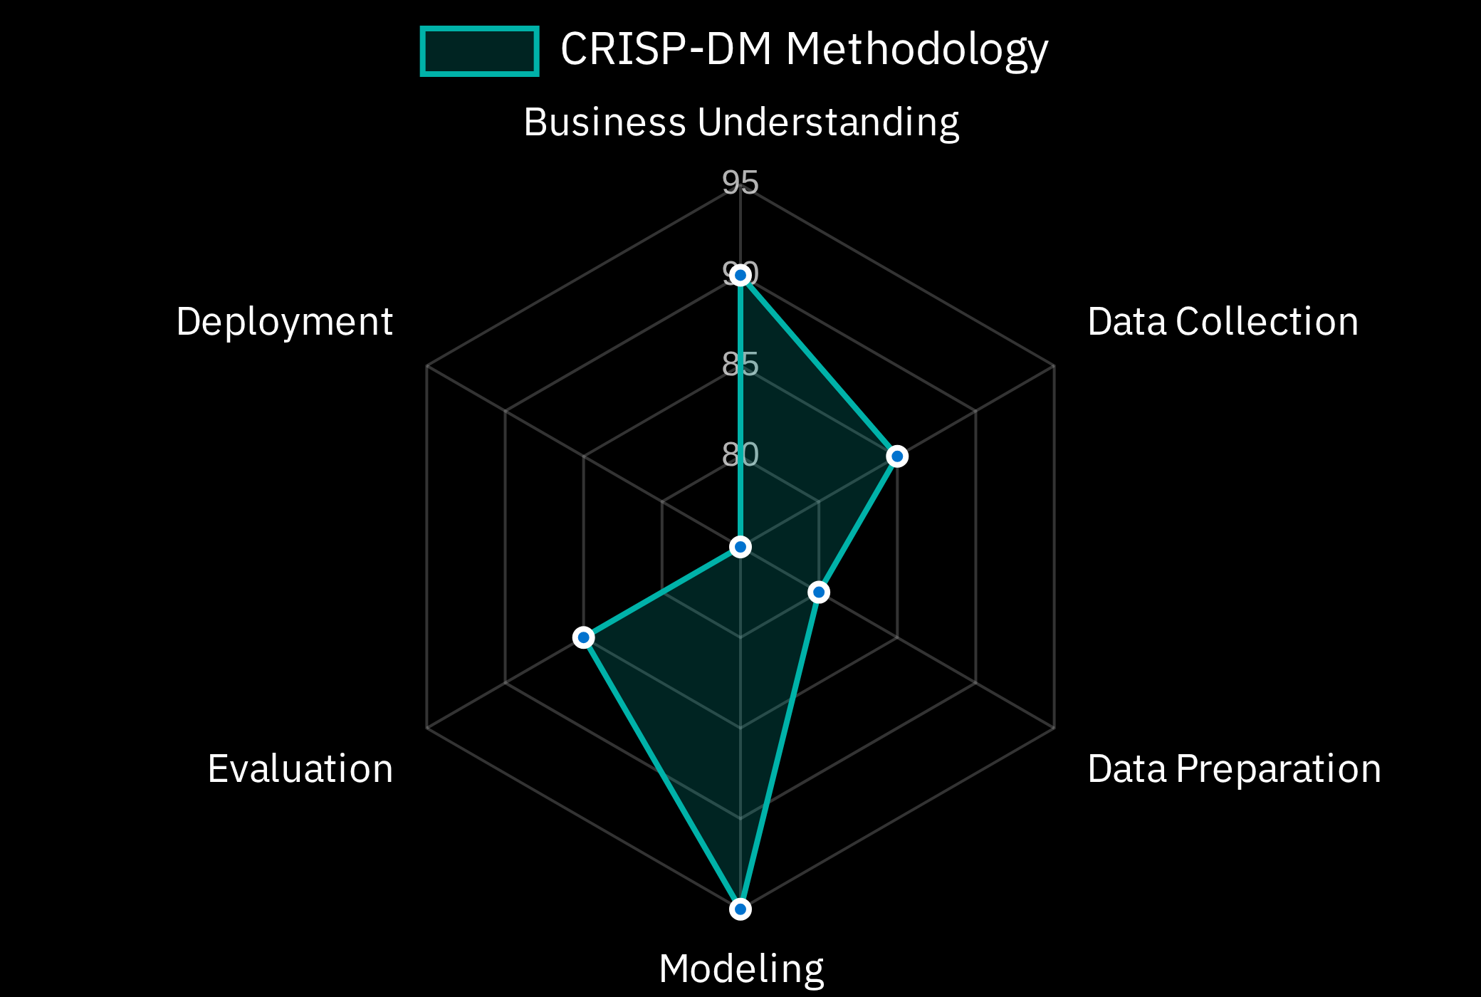













System Development Approach
Technology Stack
Development Methodology
Programming Language & Environment
Python 3.7+
Jupyter Notebook
VS Code
Libraries Required
pandas
numpy
scikit-learn
matplotlib
seaborn
streamlit
joblib
System Requirements
8GB RAM for data processing
Multi-core processor for model training
Web browser for Streamlit application

Slide 5




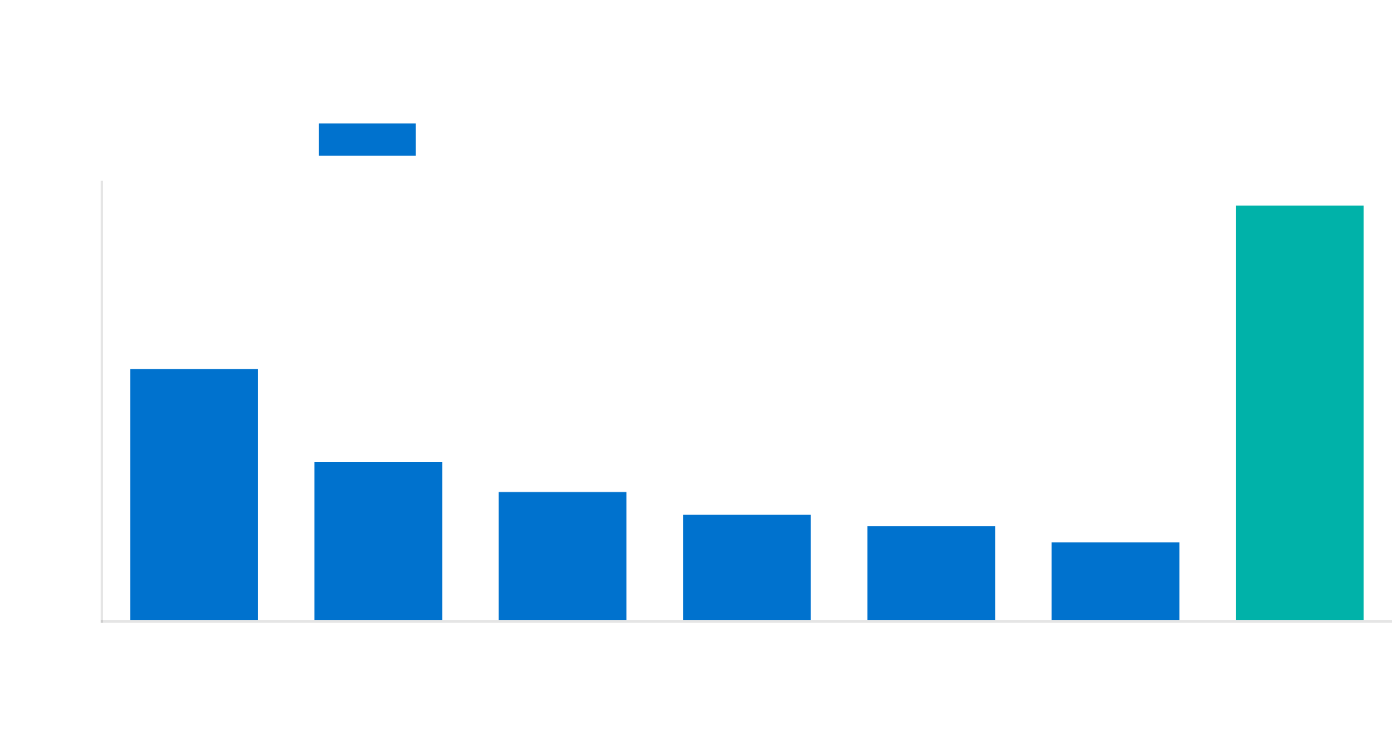

Algorithm & Deployment (Part 1)
Phase 3: Data Preprocessing
Phase 1: Data Collection & Understanding
Data quality:
No missing values found in dataset
Dataset:
689 employee records with 15 features
Validation:
Data consistency checks performed across all
features
Coverage:
20 departments across 5 countries
Feature selection:
Years of experience + Job performance rating
Salary range:
$8,436 to $41,400 annually
identified as key predictors
Phase 2: Exploratory Data Analysis
Statistical analysis:
Performed on all variables to understand
distributions and relationships
Gender distribution:
65.2% male, 34.8% female
Key finding:
Strong correlation between years of experience and
salary

Slide 6

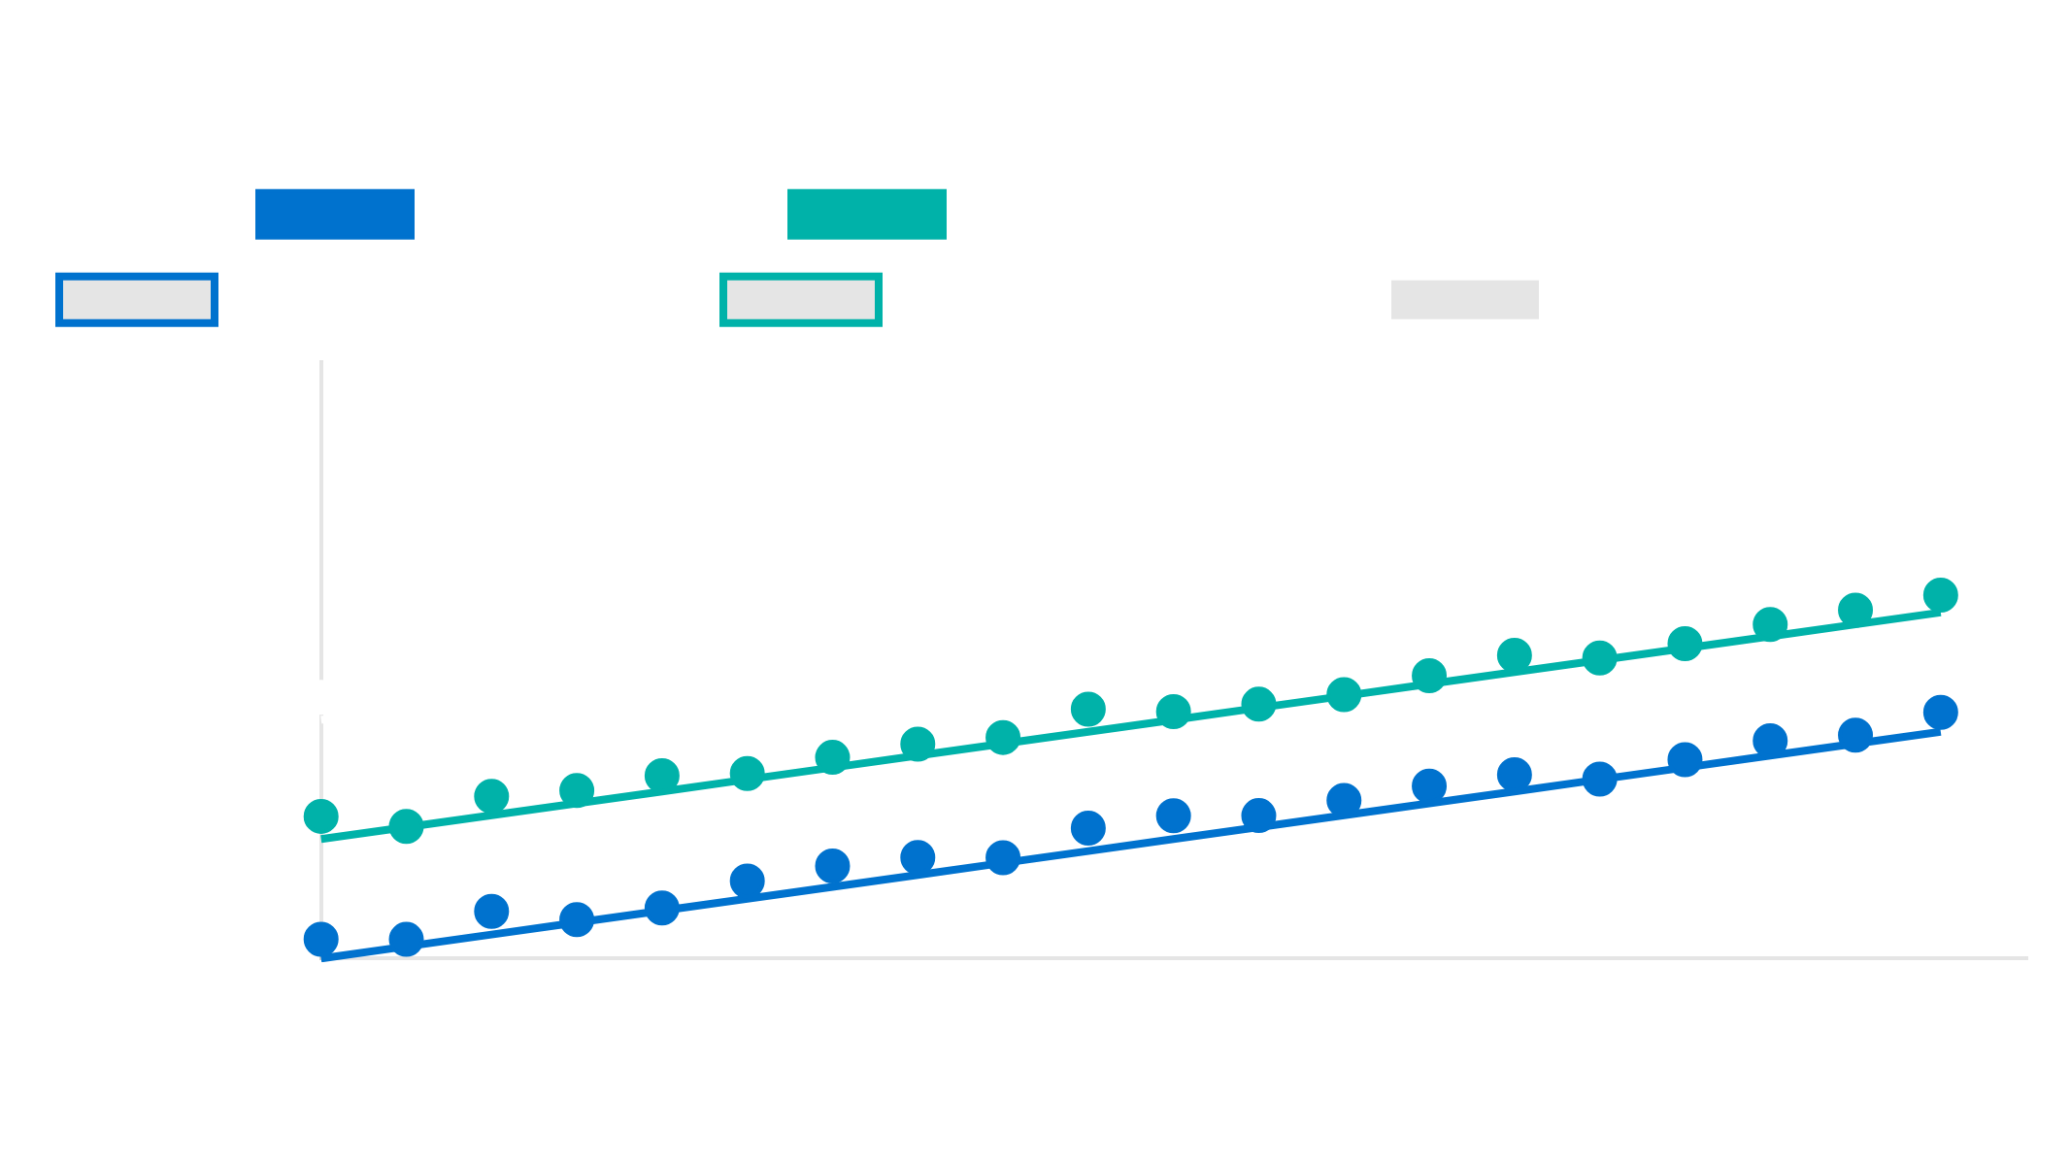
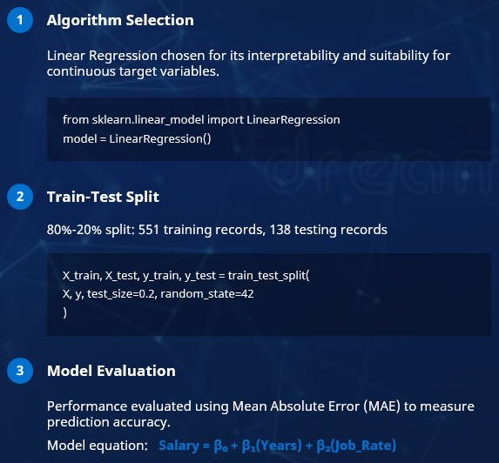
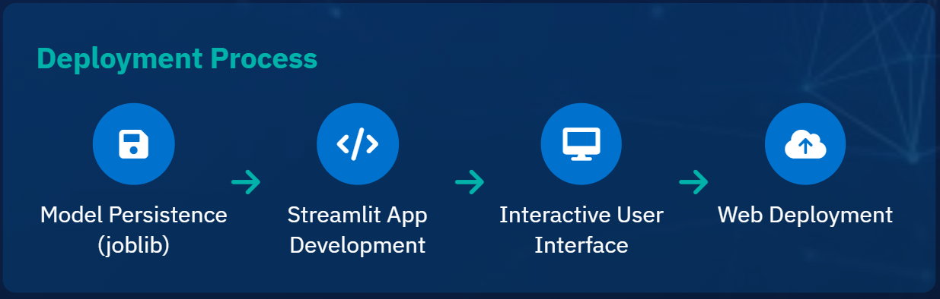
Algorithm & Deployment (Part 2)
Model Visualization
Model Development & Training
1
Algorithm Selection
Linear Regression chosen for its interpretability and suitability for continuous target variables.
from sklearn.linear_model import LinearRegression
model = LinearRegression()
2
Train-Test Split
80%-20% split: 551 training records, 138 testing records
X_train, X_test, y_train, y_test = train_test_split(
X, y, test_size=0.2, random_state=42
)

Slide 7

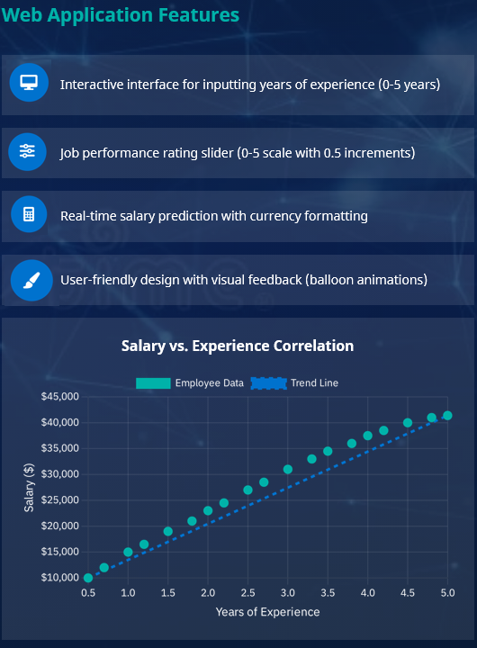
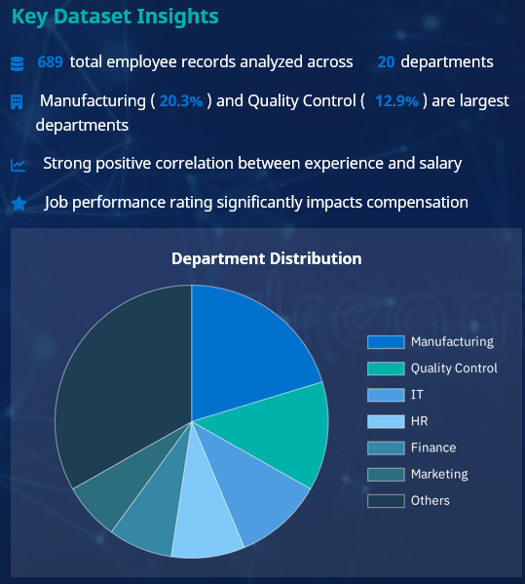








Results: Model Performance
Key Dataset Insights
Web Application Features
689
total employee records analyzed across
20
departments
Interactive interface for inputting years of experience (0-5 years)
Manufacturing (
20.3%
) and Quality Control (
12.9%
) are largest
departments
Strong positive correlation between experience and salary
Job performance rating slider (0-5 scale with 0.5 increments)
Job performance rating significantly impacts compensation
Real-time salary prediction with currency formatting
User-friendly design with visual feedback (balloon animations)

Slide 8



Results: Technical Implementation
Model Integration
Successfully integrated the trained linear regression model with a Streamlit web interface, allowing for real-time salary predictions based on user inputs.
Example Prediction
Years of Experience:
1.0
Estimated Salary:
Job Performance Rating:
3.5
₹24,681/-
Input Validation
Implemented robust input validation and error handling to ensure data integrity and prevent invalid predictions, improving user experience.
Model Deployment Code Snippet
Responsive Design
# Load the trained model
Created a responsive interface suitable for HR department use across different devices, with intuitive controls and clear visual feedback.
import
joblib
model = joblib.load(
'salary_model.pkl'
)
# Streamlit interface
import
streamlit as st
Model Persistence
experience = st.slider(
'Years of Experience'
, 0.0, 5.0, 1.0)
Saved the trained model as a pickle file for easy deployment and integration with the web application, ensuring consistent predictions.
rating = st.slider(
'Job Performance Rating'
, 0.0, 5.0, 3.5, 0.5)
if
st.button(
'Predict Salary'
):
prediction = model.predict([[experience, rating]])
)

Slide 9

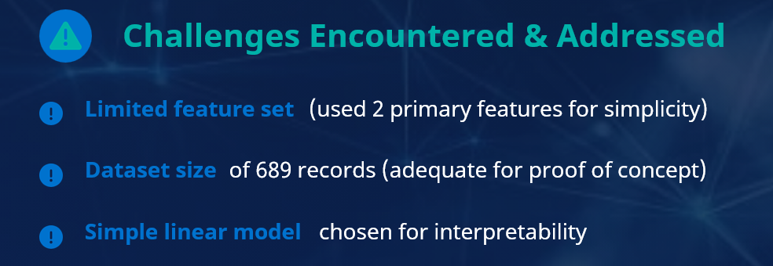
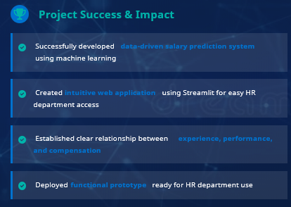


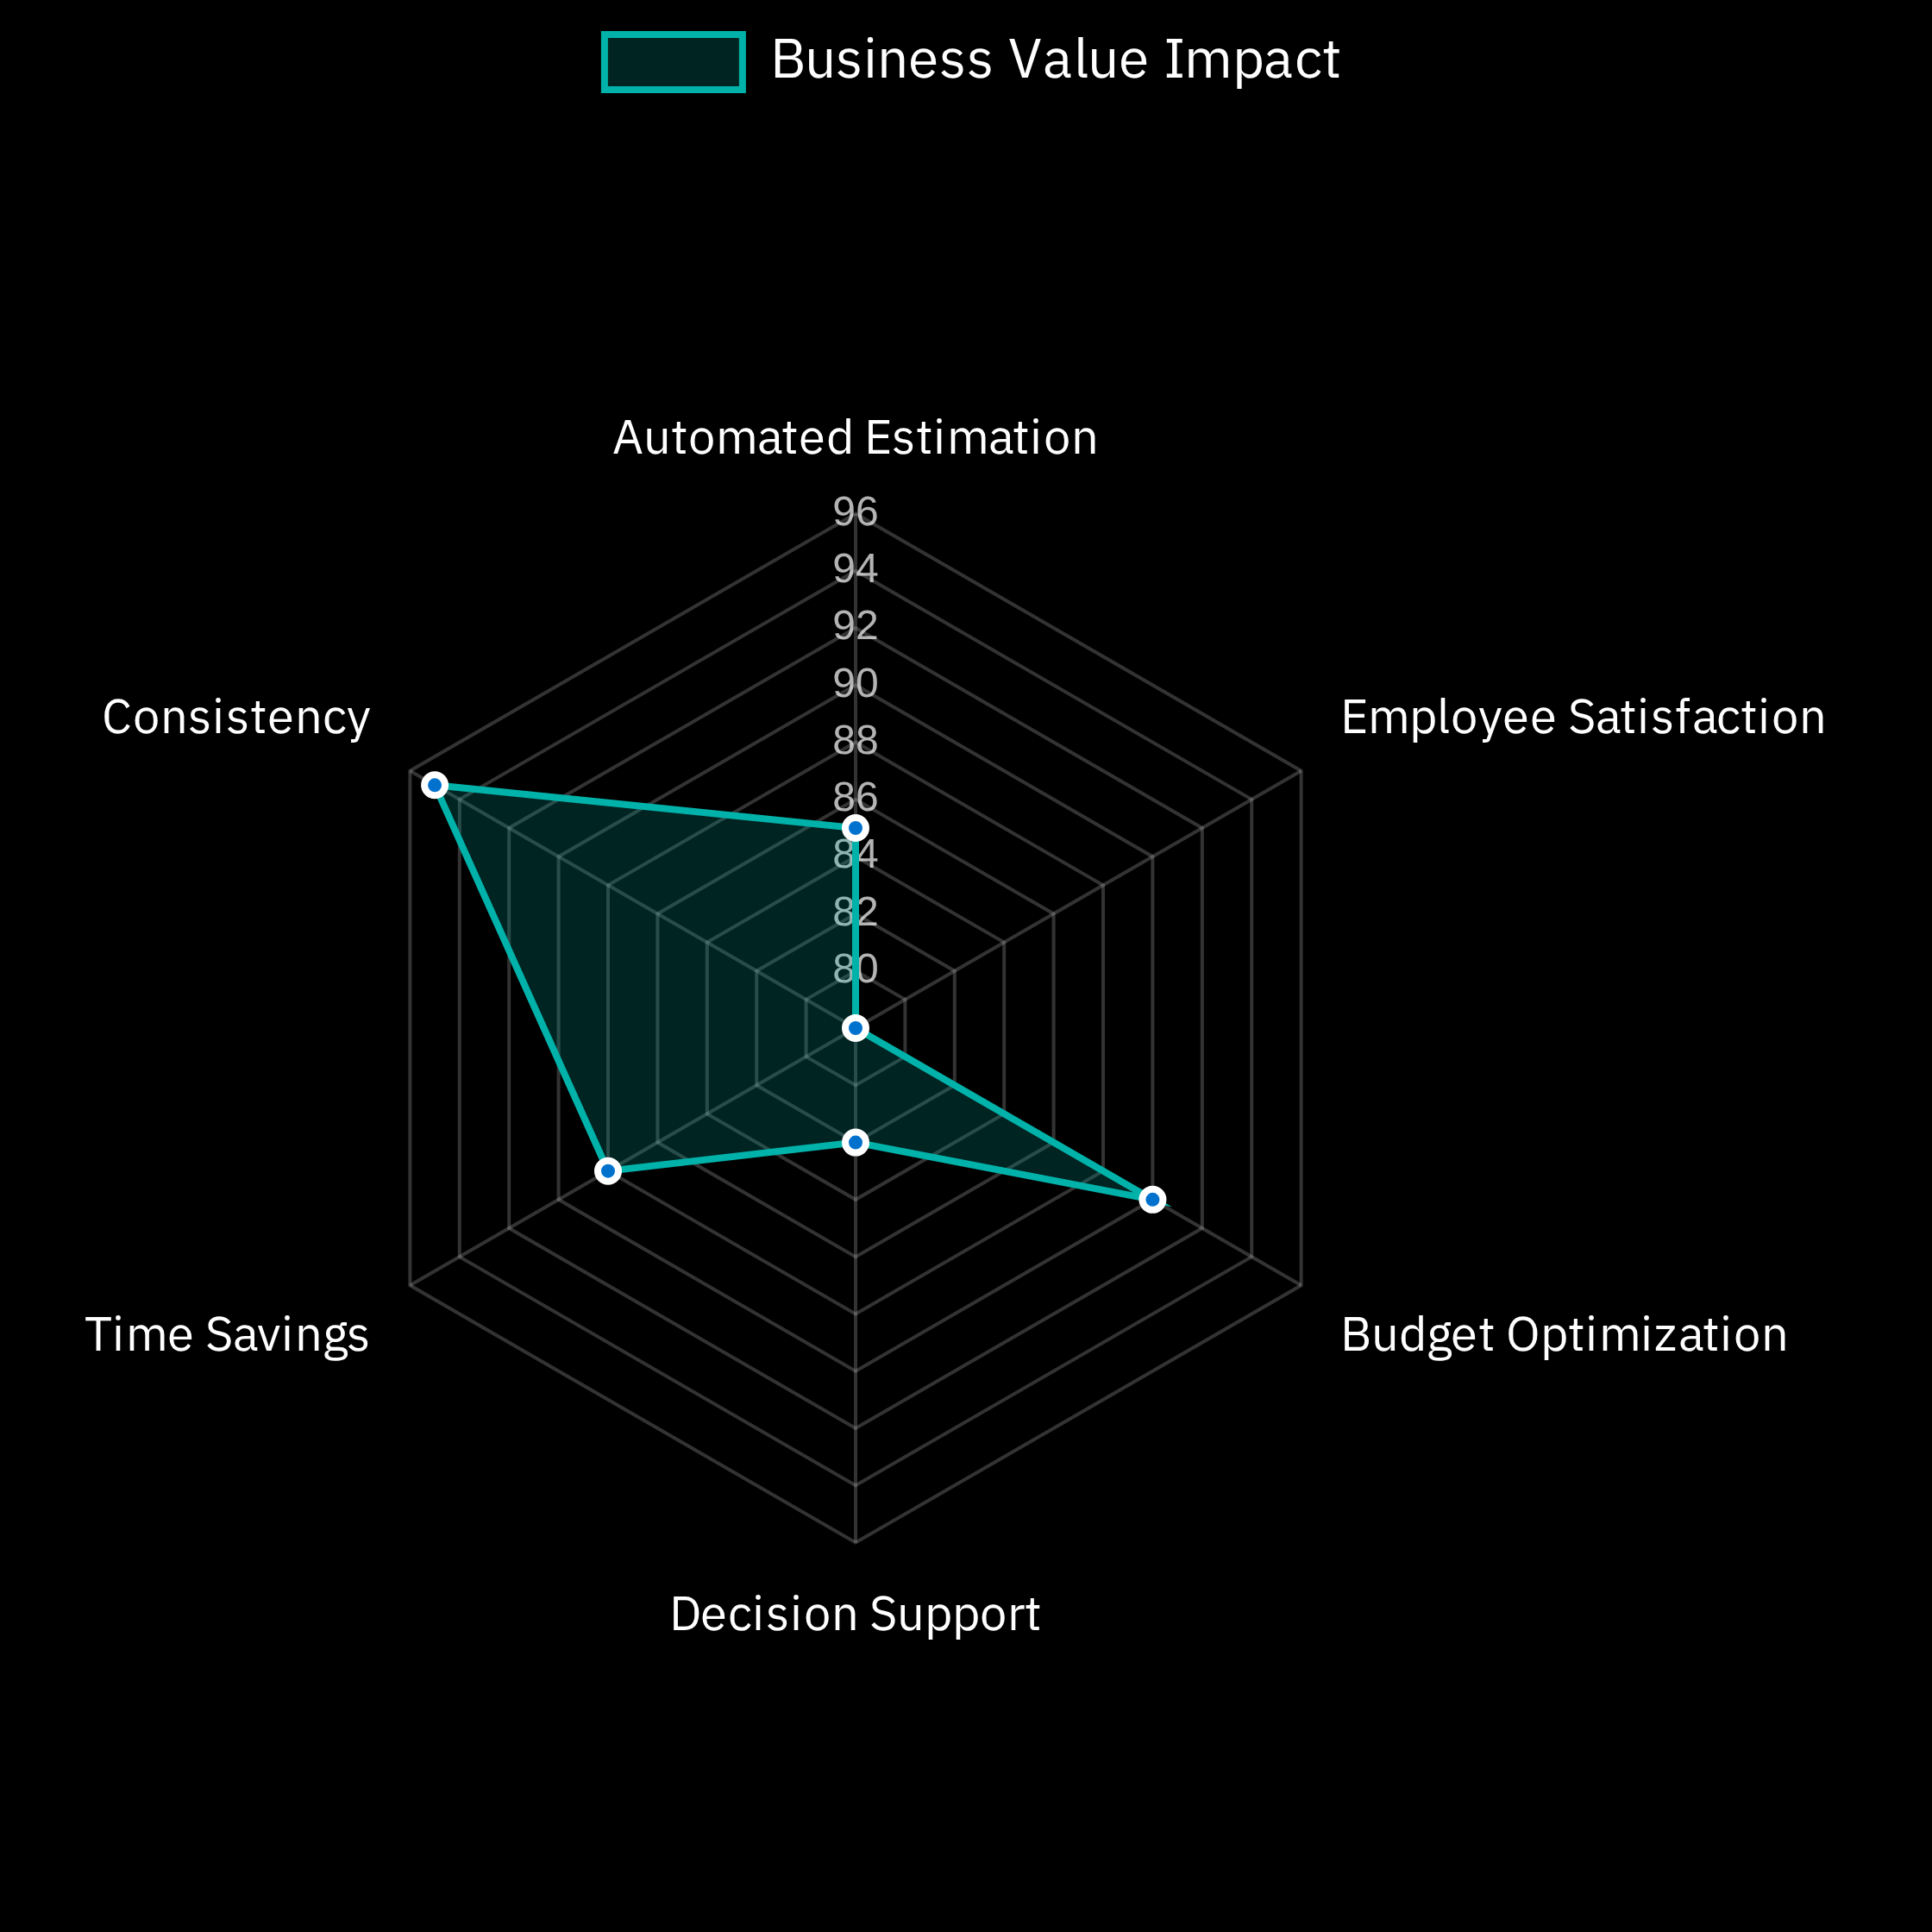

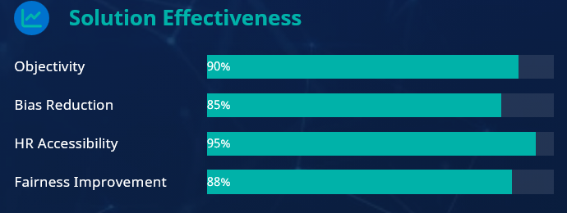
Conclusion
Project Success & Impact
Successfully developed
data-driven salary prediction system
using machine learning
Business Value
Created
intuitive web application
using Streamlit for easy HR
department access
Established clear relationship between
experience, performance,

Slide 10

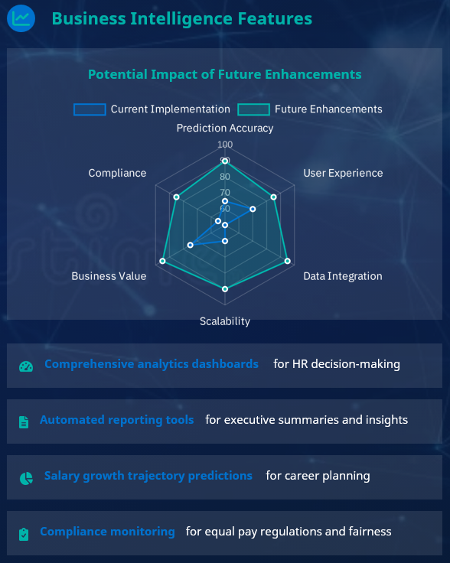
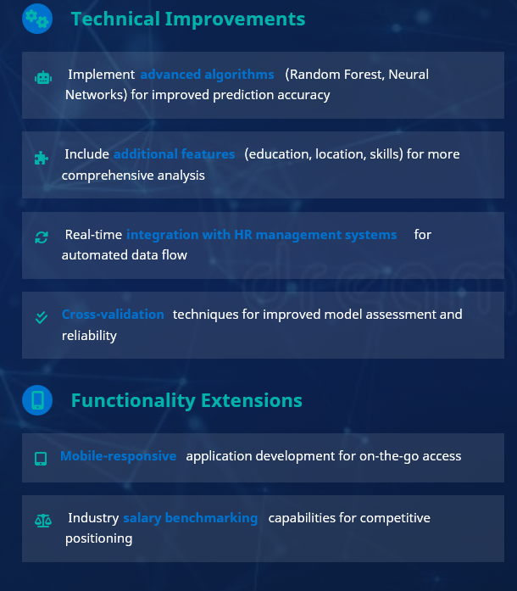






Future Scope
Technical Improvements
Business Intelligence Features
Implement
advanced algorithms
(Random Forest, Neural
Potential Impact of Future Enhancements
Networks) for improved prediction accuracy
Include
additional features
comprehensive analysis
Real-time
integration with HR management systems
for
automated data flow
Cross-validation
reliability

Slide 11



References
Data Sources
Company Employees Dataset
HR Analytics Dataset
Primary dataset used for model training and evaluation, containing 689 employee records with salary information.
Supplementary dataset used for validation and comparative analysis of salary trends.
Kaggle: https://www.kaggle.com/datasets/abdallahwagih/company-employees
Kaggle: HR Analytics
Technical Documentation
Scikit-learn Documentation
Streamlit Documentation
Official documentation for the Linear Regression implementation used in the model development.
Framework documentation used for developing the interactive web application interface.
Scikit-learn Machine Learning Library
Streamlit.io: The fastest way to build and share data apps

Slide 12


Thank You
Presented by:
T.R.J. Swarup Reddy
Andhra University - CSE (2nd year)
GitHub Repository
LinkedIn Profile
https://github.com/Swarup0809/Employee-Salary-Prediction.git
www.linkedin.com/in/t-r-j-swarup-reddy-842154333

